Slide 1

Predicting
Camera review
Ratings on

Slide 2
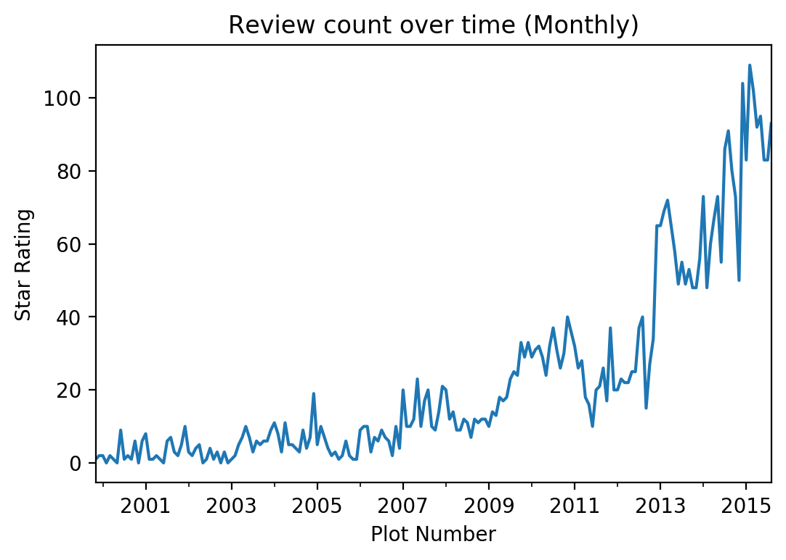
Please leave a review..
Notes:
How many reviews or feedback did you leave in the last week? (GA sent email)

Slide 3
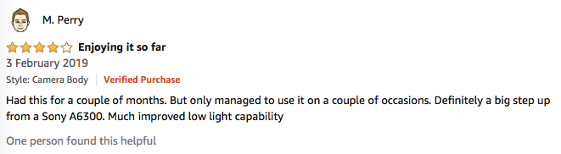
Review’s provide
customer insight

Slide 4
Reviews drive purchase decisions
1
Contextual usage information
2
Reduce risk: validate manufacturer claims
3
Understand consumer needs (met and unmet)
Notes:
High ratings in Amazons algorithm to drive conversion and make sales

Slide 5

Potential
Audience
Product developers and marketeers who are seeking opportunities in the market through unmet needs.

Slide 6

Problem
Statement
Which features should a product manager prioritise in a new camera?

Slide 7
Goals
Gain insight into which
features are divisive
in customer opinion.
Predict the product rating better than baseline score 0.713

Slide 8

Dataset
A collection of reviews written in the Amazon.com marketplace and associated metadata from 1995 until 2015.
(130M+ customer reviews)
Tab Separated .TSV
Web Scraping
https://registry.opendata.aws/amazon-reviews/
Notes:
The UK dataset was not viable as it was much smaller for observations in the Camera category (6427 before cleaning, 30 afterwards)
This is intended to facilitate study into the properties (and the evolution) of customer reviews
potentially including how people evaluate and express their experiences with respect to products at scale.
multiple languages from different Amazon marketplaces, intended to facilitate analysis of customers’ perception of the same products and wider consumer preferences across languages and countries. (200K+ customer reviews in 5 countries)
A collection of reviews that have been identified as non-compliant with respect to Amazon policies. This is intended to provide a reference dataset for research on detecting promotional or biased reviews. (several thousand customer reviews). This part of the dataset is distributed separately and is available upon request – please contact the email address below if you are interested in obtaining this dataset.

Slide 9
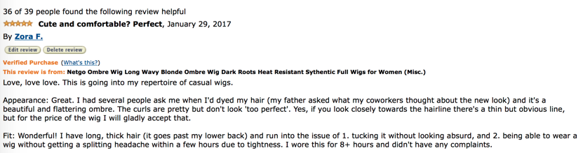
Features
Marketplace
customer_id
review_id
product_id
product_parent
product_title
product_category
star_rating
helpful_votes
total votes
vine
verified_purchase
review_headline
review_body
review_date
Features
Notes:
2 letter country code of the marketplace where the review was written.
Random identifier that can be used to aggregate reviews written by a single author.
The unique ID of the review.
The unique Product ID the review pertains to.
Random identifier that can be used to aggregate reviews for the same product.
Title of the product.
Broad product category that can be used to group reviews
The 1-5 star rating of the review.
Number of helpful votes.
Number of total votes the review received.
Review was written as part of the Vine program.
The review is on a verified purchase.
The title of the review.
The review text.
The date the review was written.

Slide 10
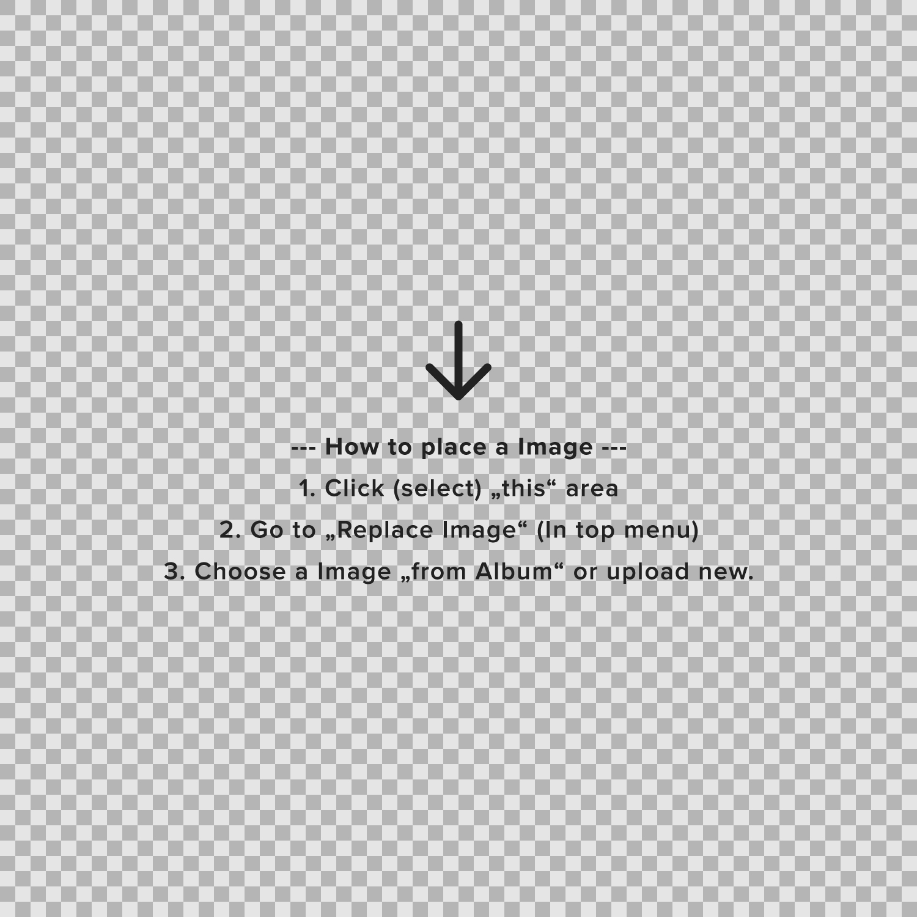

Features
Marketplace
customer_id
review_id
product_id
product_parent
product_title
product_category
star_rating
helpful_votes
total votes
vine
verified_purchase
review_headline
review_body
review_date
Process (pt 1)
Import
and cleaning
Feature Engineering
EDA
Notes:
2 letter country code of the marketplace where the review was written.
Random identifier that can be used to aggregate reviews written by a single author.
The unique ID of the review.
The unique Product ID the review pertains to.
Random identifier that can be used to aggregate reviews for the same product.
Title of the product.
Broad product category that can be used to group reviews
The 1-5 star rating of the review.
Number of helpful votes.
Number of total votes the review received.
Review was written as part of the Vine program.
The review is on a verified purchase.
The title of the review.
The review text.
The date the review was written.

Slide 11
Features
Marketplace
customer_id
review_id
product_id
product_parent
product_title
product_category
star_rating
helpful_votes
total votes
vine
verified_purchase
review_headline
review_body
review_date
Process (pt 2)
Modelling
Results
Key takeaways &
improvements

Slide 12
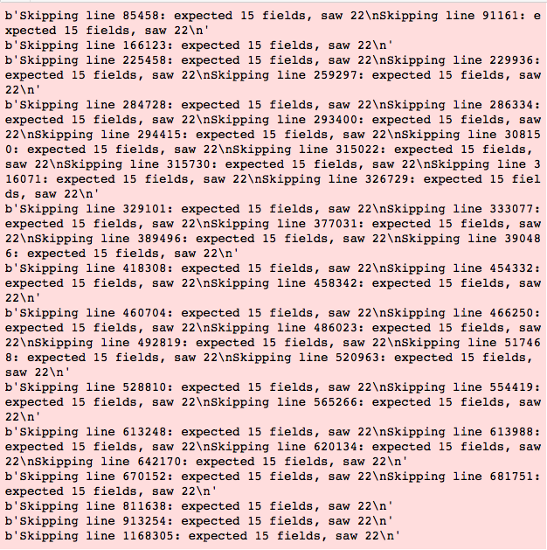
Importing

Slide 13
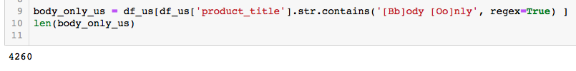
Data cleaning:
Finding only cameras
Removing columns: [Marketplace, Product Category, Vine]
No missing values
No duplicated reviews
Data types (Review Date) to datetime
Investigated outliers for numerical variables

Slide 14
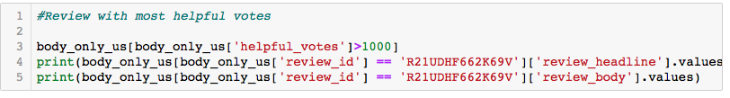
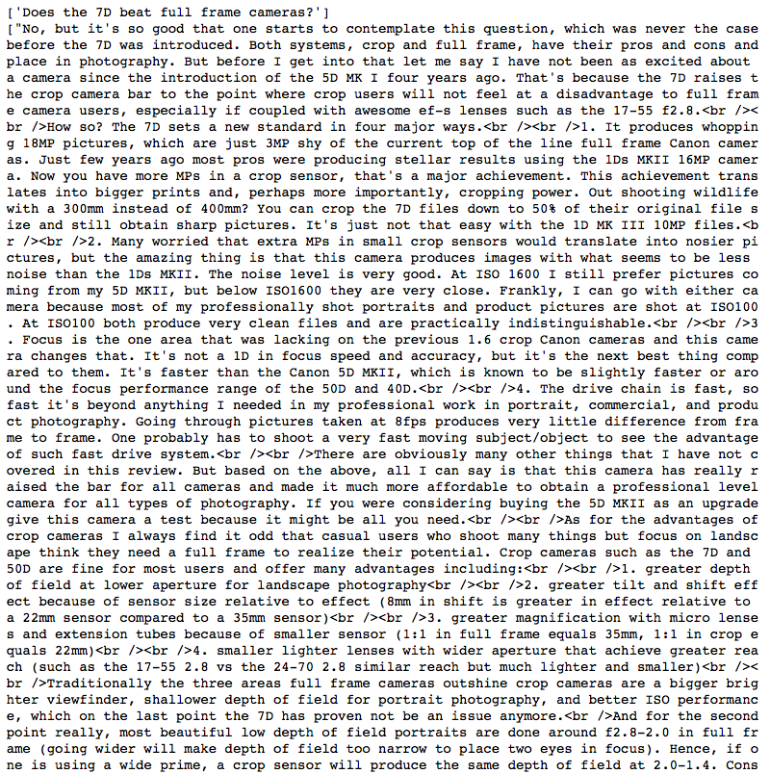
Most helpful review (outlier)

Slide 15
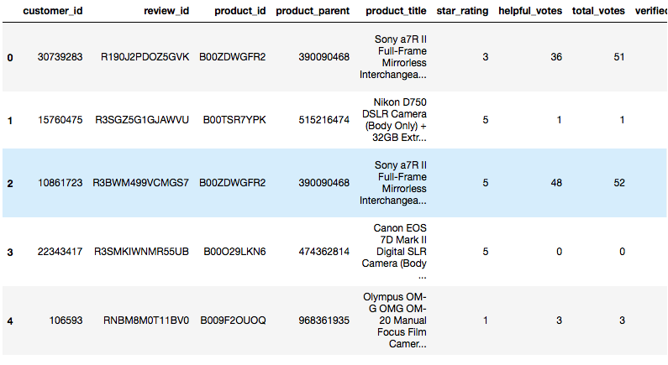
Remaining:
4260 reviews (headline and body)
397 Total unique products.

Slide 16
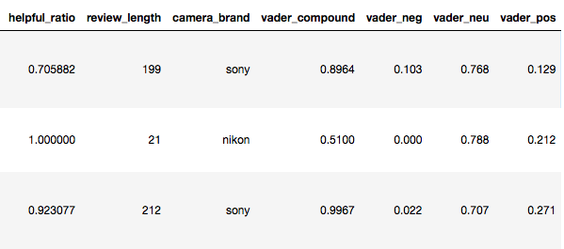
Feature engineering
helpful_ratio - Helpful votes : Total votes (fillna: 0)
review_length - Word count of review body
camera_brand - Extracted from product title. Regrouped.
VADER scores – Sentiment scores or each review
☹️🤔😀
Notes:
positive sentiment: compound score >= 0.05
neutral sentiment: (compound score > -0.05) and (compound score < 0.05)
negative sentiment: compound score <= -0.05

Slide 17
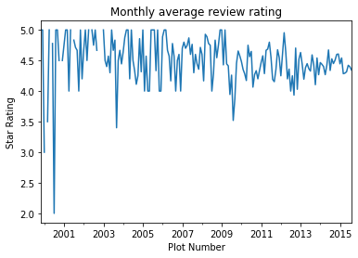
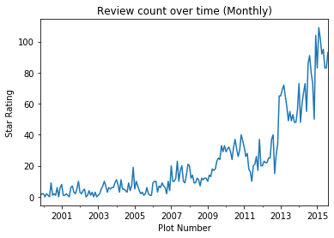
EDA: Time trends
Notes:
Average review rating is high between 4-5 only dips on certain months.
Review counts increase over the years

Slide 18
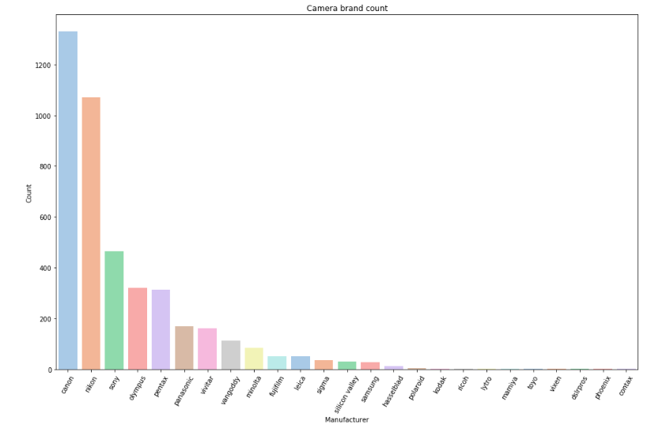
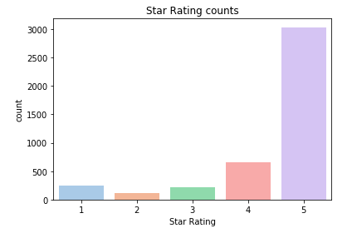
EDA: ratings, and brand counts
Brand average ratings
Canon 4.534586
Nikon 4.545709
Sony 4.496774
Vivitar 2.493827
Polaroid 2.200000
Notes:
Rating counts and brand counts
Mean star rating is 4.43 stars. Mostly positive reviews with 4 and 5 star ratings. Class imbalance in the data.
Class imbalance! Questioning accuracy as the metric!
Conventional algorithms are often biased towards the majority class, not taking the data distribution into consideration. In the worst case, minority classes are treated as outliers and ignored. For some cases, such as fraud detection or cancer prediction, we would need to carefully configure our model or artificially balance the dataset, for example by undersampling or oversampling each class.

Slide 19
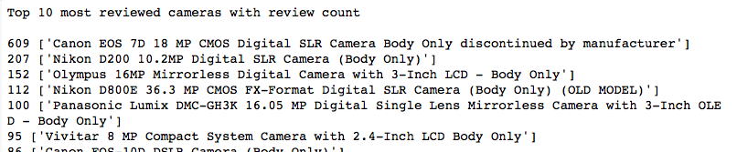
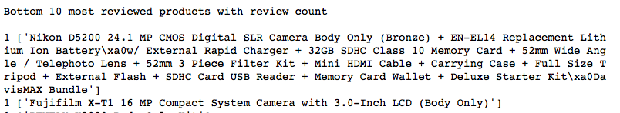
EDA: Most and least reviewed

Slide 20
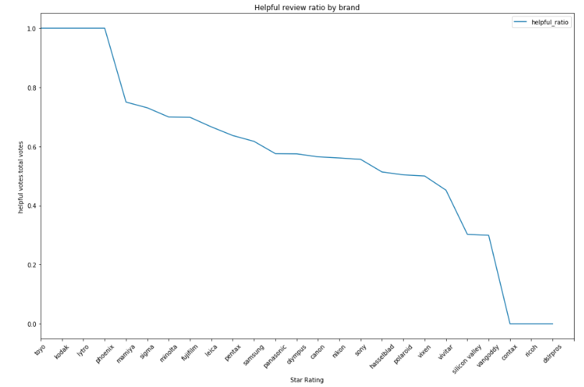
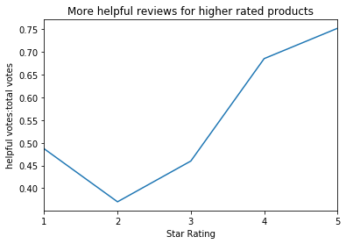
EDA: Helpful ratio
Notes:
Helpfulness
Metric used to give weight to certain reviews or quality to a prospective buyer.
On average there are 8.9 helpful votes per review with a Median of 2. One review had over 1310 helpful votes! which i display in my notebook.
The five most helpful reviews were all longer than the mean review length (190) and median (85) - [1800,1507,579,513,301]
On average more helpful reviews were left for ratings 5, 4 and 1.
star_rating (average helpfulness)
1 0.486704
2 0.369964
3 0.459751
4 0.685411
5 0.752291

Slide 21
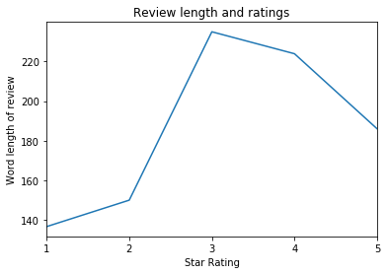
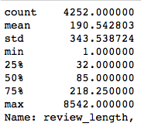
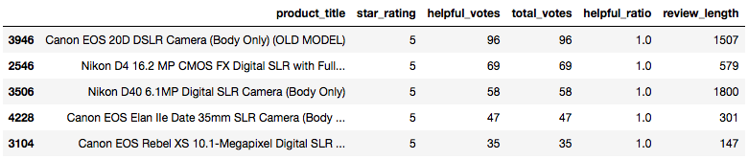
EDA: Review length
Notes:
Most helpful reviews how long are they?
One review had 1357 total votes. It was long with a good title.

Slide 22
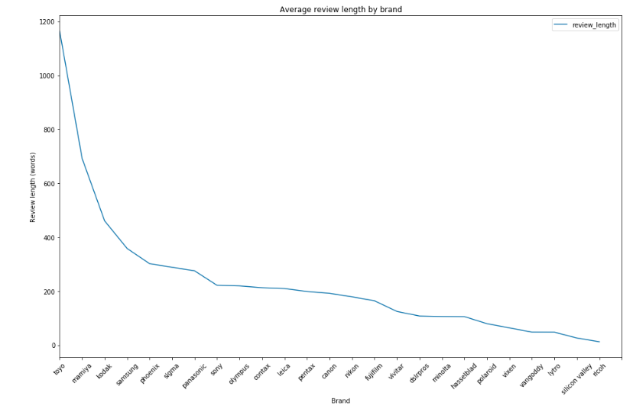
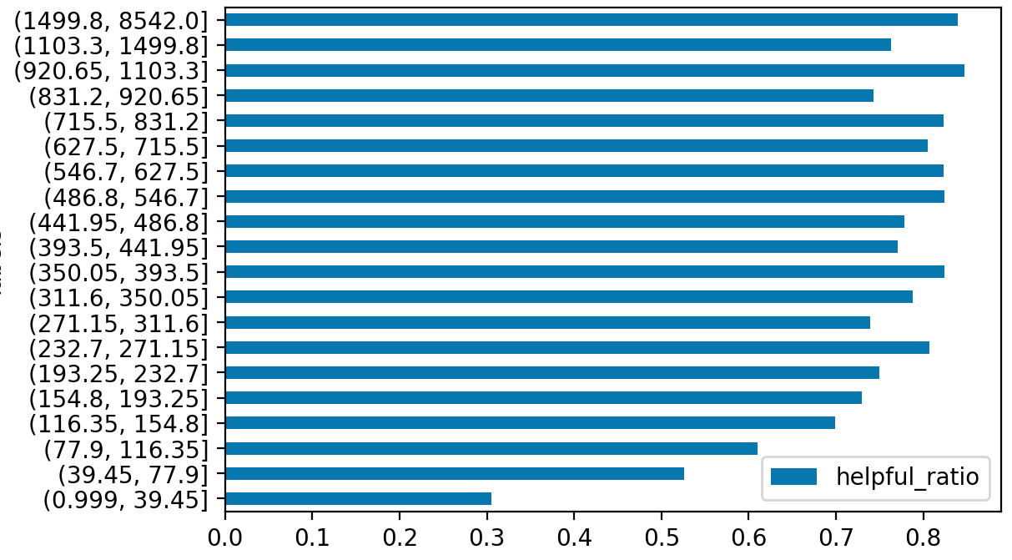
EDA: Review length
Review length helpfulness ratio
Word count
Notes:
Most helpful reviews how long are they?
One review had 1357 total votes. It was long with a good title.

Slide 23
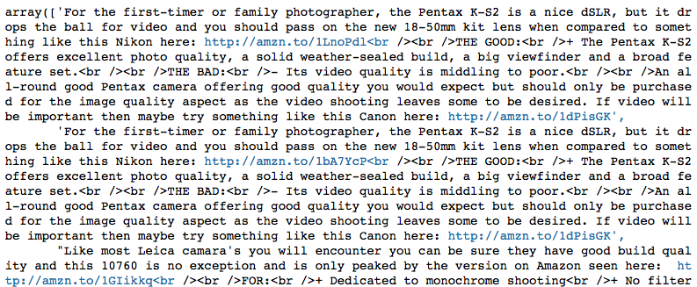
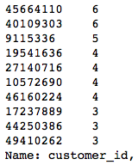
EDA: Reviewer behaviour
Notes:
Reviewers
Repeat reviewers.
A handful of users gave multiple reviews in this sample. Two users gave 6 reviews.
Found some affiliate spam looking reviews by the most frequent reviewer.
Reviewers who write alot tend to have a high helpful ratio.

Slide 24
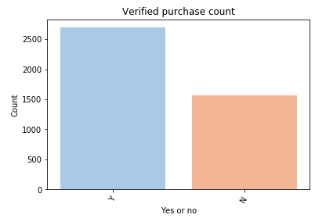
EDA: Verified purchases
Notes:
Problems – show most frequent reviewer

Slide 25
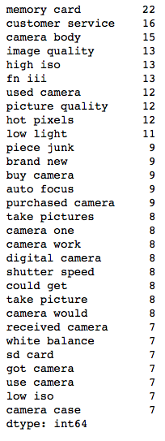
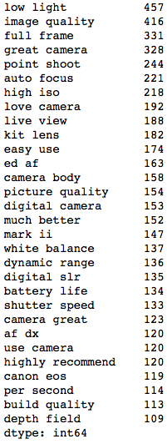
EDA: text features
One star reviews
Five star reviews
Notes:
Popular words and ngram range
Most popular words in 5 star reviews and 1

Slide 26
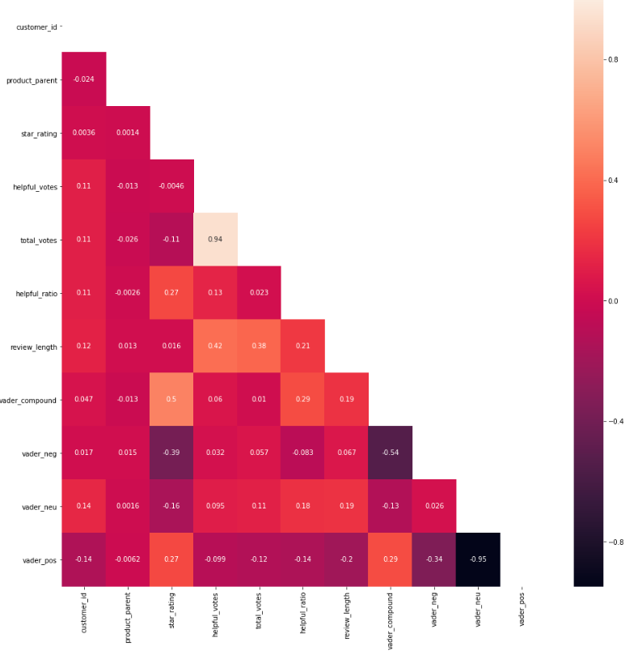
Heatmap
Notes:
Correlation heat map:
shows that helpful_ratio has some positive explanatory power (0.27) to the star rating.
Vader negative as expected -0.39
Vader compound has the most correlation with star rating at 0.5

Slide 27

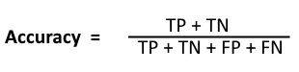
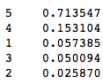
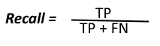
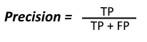
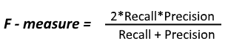
Success Metrics
Model that performs above the baseline score 0.713.
Accuracy, Precision, Recall, F1.
Class mean
Notes:
One of my setbacks I encountered is after scraping current Amazon products “total votes” is no longer shown on the website. Therefore I can’t construct another helpful ratio for new current cameras. On the other hand I can also scrape pricing data.
The risks in this dataset are that the review body is very large and computing power will be a limitation. Also accuracy will be difficult to predict 5 classes of ratings. Potentially it would have been easier to predict positive or negative. Skewed data

Slide 28
Model: single feature [review body]
Model | Parameters | Cross Val Train (Accuracy) | Test set (Accuracy) | Weighted Average (Precision) | Weighted Average (Recall) | F1
Logistic Regression Count Vectoriser | solver='lbfgs', multi_class='ovr', max_iter=1000, class_weight='balanced') | 0.7095 | 0.7109 | 0.5679 | 0.7109 | 0.5997
LogisticRegression TfidfVectorizer | solver='lbfgs', multi_class='ovr', max_iter=1000, class_weight='balanced') | 0.6792 | 0.6992 | 0.7142 | 0.6992 | 0.7028
Multinomial Naive Bayes TfidfVectorizer |  | 0.7136 | 0.7133 | 0.5088 | 0.7133 | 0.5939
Random Forest TfidfVectorizer | n_estimators=200, class_weight='balanced') | 0.7116 | 0.7168 | 0.6639 | 0.7168 | 0.6024
KNeighborsClassifier TfidfVectorizer | n_neighbors=5) | 0.6983 | 0.6804 | 0.5712 | 0.6804 | 0.6031
SVM: Support Vector Classifier TfidfVectorizer | class_weight='balanced', gamma='auto', kernel='linear') | 0.6442 | 0.6569 | 0.6912 | 0.6569 | 0.6678
Notes:
Gradient Boosting

Slide 29
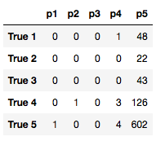
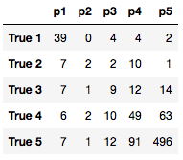
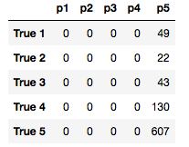
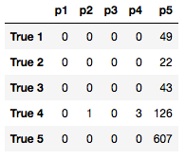
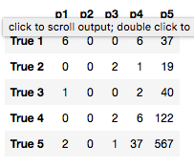
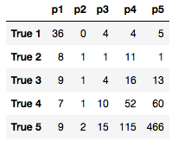
Model: single feature [review body]
Logistic Regression Count Vectoriser | LogisticRegression TfidfVectorizer | Multinomial Naive Bayes TfidfVectorizer | Random Forest TfidfVectorizer | SVM: Support Vector Classifier TfidfVectorizer | SVM: Support Vector Classifier TfidfVectorizer
0.7109 | 0.6992 | 0.7133 | 0.7168 | 0.6804 | 0.6569
0.7095 | 0.6792 | 0.7136 | 0.7116 | 0.6983 | 0.6442
0.5997 | 0.7028 | 0.5939 | 0.6024 | 0.6031 | 0.6678
Test
Train
F1
Notes:
test

Slide 30
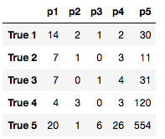
Model: Sentiment vs review body (single feature)
Model | Parameters | Cross Val Train (Accuracy) | Test set (Accuracy) | Weighted Average (Precision) | Weighted Average (Recall) | F1
Random Forest Standard Scalar | n_estimators=100, class_weight='balanced' | 0.9712 | 0.6733 | 0.5673 | 0.6733 | 0.6093
LogisticRegression TfidfVectorizer on review body | solver='lbfgs', multi_class='ovr', max_iter=1000, class_weight='balanced') | 0.6792 | 0.6992 | 0.7142 | 0.6992 | 0.7028
Random Forest
Logistic Regression TFIDF
Notes:
What were your findings? The baseline score is 0.713146 because the amount of 5 star reviews in the dataset are the majority. My results on the test set ranged from 0.71 to 0.72 which was not much of an improvement. But with only one predictor.
Accuracy - SCORES and confusion matrix – more complex
Precision Recall F1
Logistic Regression CVEC
LogisticRegression TFIDF
Multinomial Naive Bayes
Random Forest
Gradient Boosting
KNeighborsClassifier
SVM: Support Vector Classifier

Slide 31
Model: Multiple features
helpful_ratio
review_length
vader_compound
vader_pos
vader_neu
vader_neg
camera_brand
verified_purchase
review_body
Notes:
MULTIPLE Features: ['helpful_ratio','verified_purchase','review_body','review_length','camera_brand','vader_compound','vader_pos','vader_neu','vader_neg']

Slide 32
Model: Multiple features
Model | Parameters | Cross Val Train (Accuracy) | Test set (Accuracy) | Weighted Average (Precision) | Weighted Average (Recall) | F1
Logistic Regression Count Vectoriser | solver='lbfgs', multi_class='ovr', max_iter=1000, class_weight='balanced') | 0.6025 | 0.6204 | 0.5749 | 0.6204 | 0.5948
LogisticRegression TfidfVectorizer | solver='lbfgs', multi_class='ovr', max_iter=1000, class_weight='balanced') | 0.6939 | 0.6616 | 0.6198 | 0.6616 | 0.6356
Multinomial Naive Bayes TfidfVectorizer |  | 0.6336 | 0.6192 | 0.6228 | 0.6193 | 0.6181
Random Forest TfidfVectorizer | n_estimators=200, class_weight='balanced') | 0.7230 | 0.7321 | 0.6413 | 0.7321 | 0.6369
KNeighborsClassifier TfidfVectorizer | n_neighbors=5) | 0.6933 | 0.7121 | 0.5964 | 0.7121 | 0.6261
SVM: Support Vector Classifier TfidfVectorizer | class_weight='balanced', gamma='auto', kernel='linear') | 0.5322 | 0.5335 | 0.5980 | 0.5335 | 0.5604
Notes:
MULTIPLE Features: ['helpful_ratio','verified_purchase','review_body','review_length','camera_brand','vader_compound','vader_pos','vader_neu','vader_neg']

Slide 33
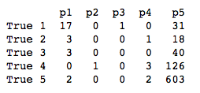
Model: Multiple features vs only review body
Model | Parameters | Cross Val Train (Accuracy) | Test set (Accuracy) | Weighted Average (Precision) | Weighted Average (Recall) | F1
Random Forest TfidfVectorizer | n_estimators=200, class_weight='balanced') | 0.7230 | 0.7321 | 0.6413 | 0.7321 | 0.6369
LogisticRegression TfidfVectorizer on review body | solver='lbfgs', multi_class='ovr', max_iter=1000, class_weight='balanced') | 0.6792 | 0.6992 | 0.7142 | 0.6992 | 0.7028
Random Forest (multiple features)
Logistic Regression TFIDF
Notes:
What were your findings? The baseline score is 0.713146 because the amount of 5 star reviews in the dataset are the majority. My results on the test set ranged from 0.71 to 0.72 which was not much of an improvement. But with only one predictor.
Accuracy - SCORES and confusion matrix – more complex
Precision Recall F1
Logistic Regression CVEC
LogisticRegression TFIDF
Multinomial Naive Bayes
Random Forest
Gradient Boosting
KNeighborsClassifier
SVM: Support Vector Classifier

Slide 34
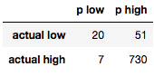
Model: Binary problem (Predict high or low)
Model | Parameters | Cross Val Train (Accuracy) | Test set (Accuracy) | Weighted Average (Precision) | Weighted Average (Recall) | F1
LogisticRegression TfidfVectorizer | solver='lbfgs', multi_class='ovr', max_iter=1000, class_weight='balanced') | 0.9130 | 0.9084 | 0.8992 | 0.9084 | 0.9031
Random Forest TfidfVectorizer | n_estimators=200, class_weight='balanced') | 0.9272 | 0.9282 | 0.9177 | 0.9282 | 0.9131
KNeighborsClassifier TfidfVectorizer | n_neighbors=5) | 0.9180 | 0.9220 | 0.9122 | 0.9220 | 0.8973
SVM: Support Vector Classifier TfidfVectorizer | class_weight='balanced', gamma='auto', kernel='linear') | 0.8799 | 0.8774 | 0.8973 | 0.8775 | 0.8861
Best Model (Random Forest)
Notes:
MULTIPLE Features: ['helpful_ratio','verified_purchase','review_body','review_length','camera_brand','vader_compound','vader_pos','vader_neu','vader_neg']

Slide 35
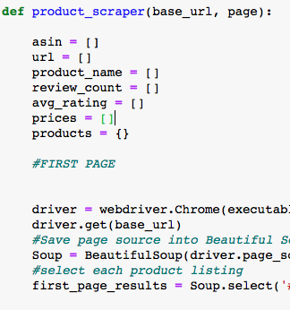
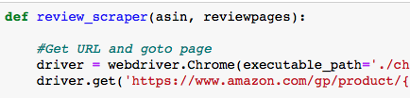
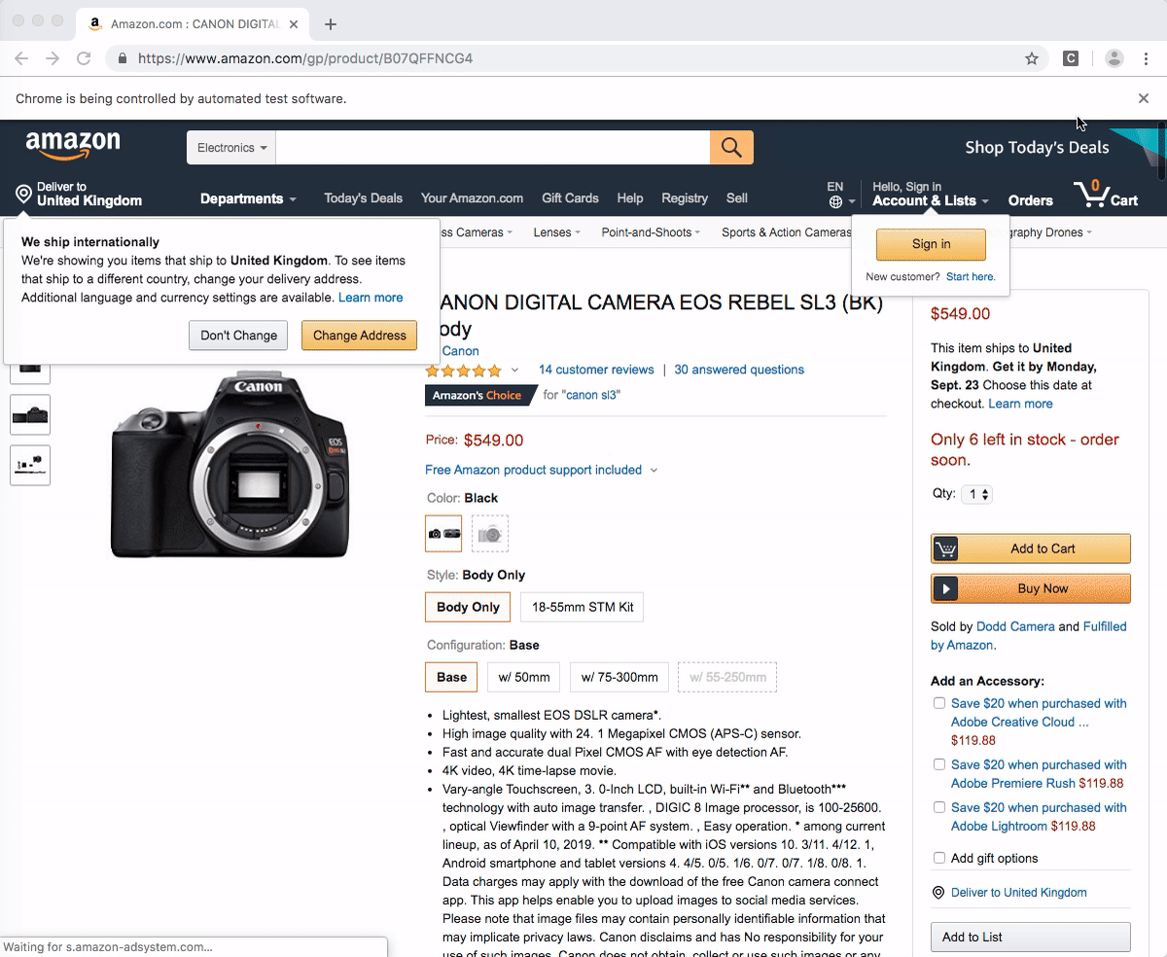
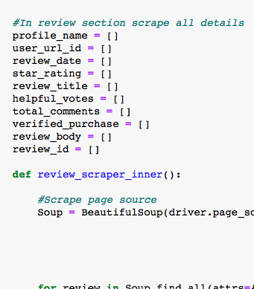
Scraping current reviews (investigating class imbalance)
Notes:
Name columns I scraped and the ones missing
Ensure feature names are the same
Make sure it's only cameras, splice on price <50 df_clean = df_clean[df_clean['Price'] > 50]
Remove sponsored ads by url begins with /gp/ or will removing duplicat ASINS be enough?
Features Needed to match original dataset*
No but redundant
marketplace
vine
product_parent (what is this)
No
total_votes (cant find it)
customer_id (doesnt seem to be in the URL, amazon must have anonymised dataset)
Yes
review_id
product_category (inferred from scrape)
product_title (infer from product_id?)
product_id (asin that i'm feeding in)
star_rating
review_headline
review_body
review_date
helpful_votes
verified_purchase

Slide 36
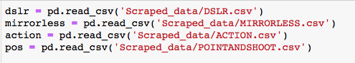
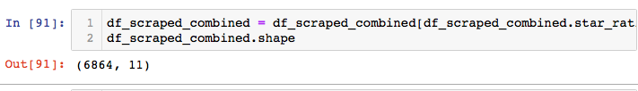
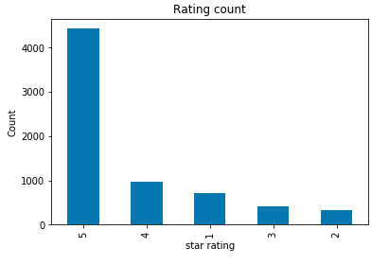
Web Scraping (6864 recent reviews)
Notes:
Ensure feature names are the same
Make sure it's only cameras, splice on price <50 df_clean = df_clean[df_clean['Price'] > 50]
Remove sponsored ads by url begins with /gp/ or will removing duplicat ASINS be enough?
Features Needed to match original dataset*
No but redundant
marketplace
vine
product_parent (what is this)
No
total_votes (cant find it)
customer_id (doesnt seem to be in the URL, amazon must have anonymised dataset)
Yes
review_id
product_category (inferred from scrape)
product_title (infer from product_id?)
product_id (asin that i'm feeding in)
star_rating
review_headline
review_body
review_date
helpful_votes
verified_purchase

Slide 37
Key takeaways:
Prioritise features: low light, image quality, full frame, auto focus
Opportunities: memory card, customer service, camera body, image quality, high iso
Amazon reviews are skewed towards high ratings.
F1 is a more suitable metric in multi class problem due to the class imbalance.
Binary predictor performs fairly well: 0.9131 F1 score

Slide 38
Limitations:
Further parameter tuning required
Text features are noisy.
Class Imbalance in data
How legitamate are non-verified reviews? Did they actually purchase?

Slide 39
Next Steps:
Identify misclassified observations, update stop words and further text preprocessing.
Parameter tuning
Conduct over and under sampling methods
Further feature engineering
Consider multiple camera types and price points on scraped dataset

Slide 40
Thank you.

Slide 41

Technology List
Python
This project using Python-3.6 environment
Numpy
The fundamental package for scientific computing with Python
Pandas
Easy-to-use data structures and data analysis tools for Python
Beastiful Soup
Convert web page to xml so that all infomation on that page can be accessed and scraped easily
Selenium
Function as automates browsers in order to scrape infomation held by JavaScript
Seaborn
A Python visualization library provides a high-level interface for drawing attractive statistical graphics.
Sci-kit Learn
Simple and efficient package for data mining and data analysis
spaCy and textacy
Python library for performing a variety of Natural Language Processing (NLP tasks)

